Slide 1


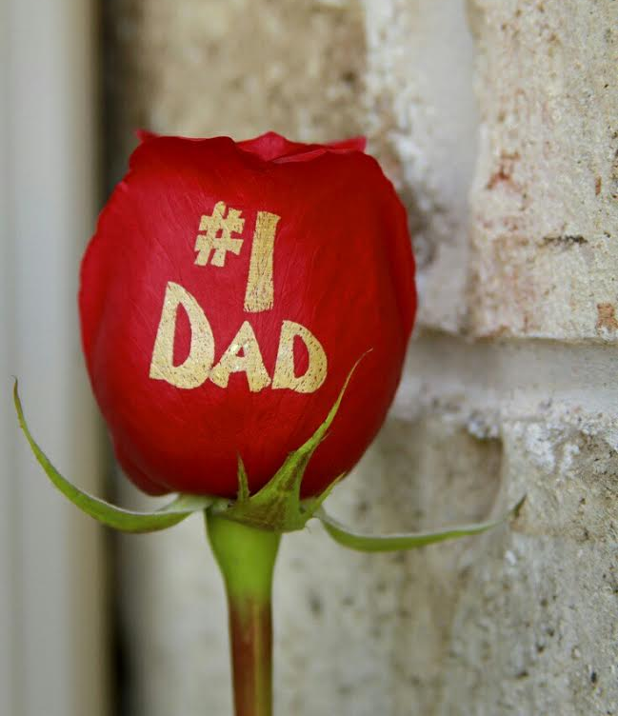
Home page
Put background of printed roses in animation (pictures supplied)

Slide 2
Who is Rose Expressions? (About Us)
Florists with a difference
Rose expressions is run by a family with a passion for flowers, whether it be giving or receiving them. The business is run from Hartbeespoort.
The ‘rose expression’ technique involves personal messages, photo, images on FRESH flowers without harming or shortening the life of the flowers. This enables it to create a unique, one of a kind gift that promises memories forever and brings joy not only to the receiver but also to the giver of the gift. This is a beautification strategy that allows fresh flowers to speak to the receiver.
People send personalised flowers to celebrate birthdays, valentines, new born, weddings, proposals, anniversaries. Also for people that are not feeling well and funerals.
Everyone loves to be appreciated. We are your source to provide that premium experience.
Now, ‘Say it with flowers’ is not just a phrase, it’s a reality. The rose that broke the paradigm of roses. Sure, a red rose means love and a yellow one means friendship, but now a rose can mean so much more. You can spell it out ON the ‘rose’
OUR TEAM

Slide 3


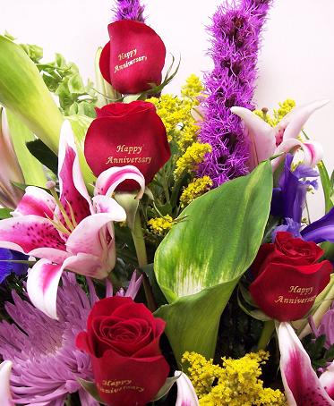
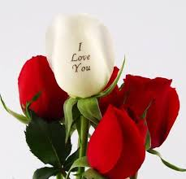
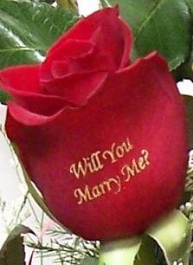
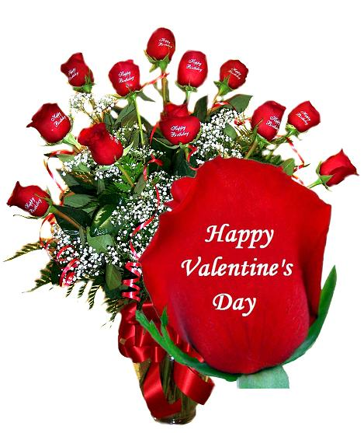
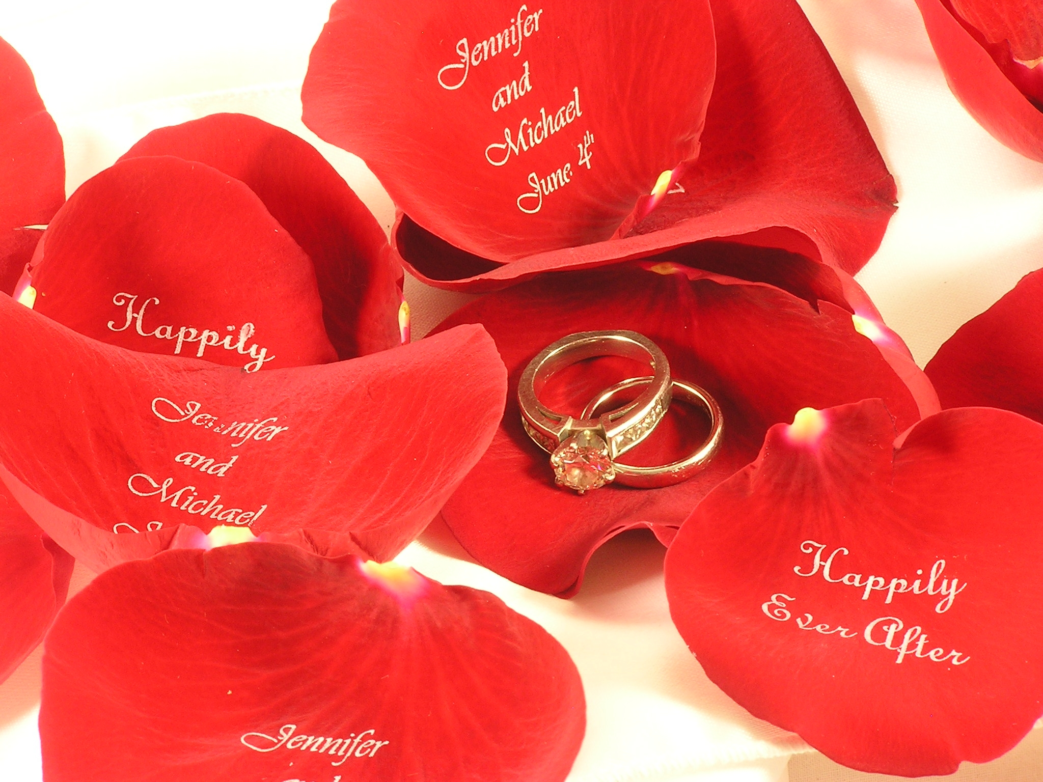

WHAT WE DO……
Believe It ! We print on Fresh Flowers
Roses with standard message ( I Love You, I’m Sorry, Happy Birthday, Congratulations, Happy Mother’s/Father’s day, Happy Valentines etc.)
Create your message (Personalised message)
Mixed flower bouquet with printed roses
Corporate advertising (Logo advertising on FRESH Flowers is a new way to promote your business. You can send roses with your company logo printed on petals as a gift to your employees showing your appreciation.)
Wedding confetti (printing bride and groom’s names on petals)

Slide 4



Order now!
Expression Rose
Expression roses allow you to express your feelings through this unique way of expression.
Print special messages direct onto a single fresh cut rose.
Single rose with a standard message: R 25
Single rose with a personalised message: R 40
Bring your own rose and we print a standard message: R 15

Slide 5

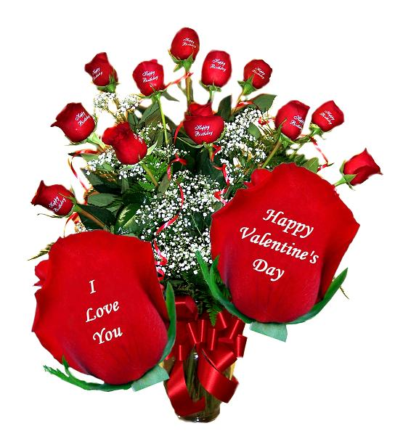
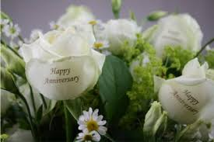
Give Someone A Smile Today
Bouquets
Mixed bouquets with printed roses R
Special occasion bouquets R
Special occasion bouquets R

Slide 6

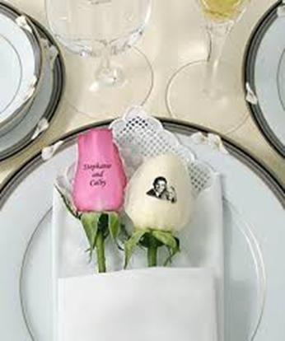


orders
Here are some ideas on how you can use these roses:
Use them as place settings at the tables.
Hand them to your guests as they come through your reception.
Have them bunched up in a central location (like a centrepiece)
Get the standard phrases "Reserved" and use them to mark your reserved tables.
Get the standard phrases "Table #" and use these to mark the table numbers and assign the table numbers to the guests by giving them a matching rose as they come in.
Aisle runners
Flower girl
Guests to toss after ceremony
On tables as part of centerpieces
Make a rose petal pathway
Dance floor
Wedding Rose Petals R
Wedding arrangements R
Proposal bouquets R

Slide 7
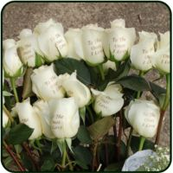
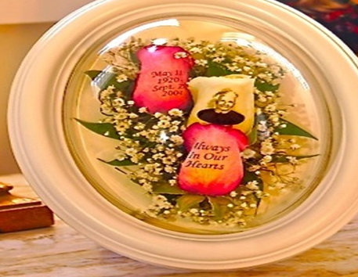

Order your unique rose now….
These roses are embossed with the phrase. To the One I Love and are handed to loved ones attending the graveside burial. After the service, the loved ones can keep the rose as a remembrance or they can be placed upon the coffin as final respects are paid.
Funeral arrangements R

Slide 8
Contact us:
Tel: +27 12 259 0046
Cell: +27 71 852 1053
+27 83 601 2888
Email: info@roseexpressions.co.za
Enquiry form and ask for a quote

